Slide 1
Cinemunchies
Team Urkel
May 2018

Slide 2
Contents
Team Urkel
Mission & Values
Project structure
Description of project
Project selection process
Our approach
Tools and technologies
Features and functions
Our challenges
Our successes
What we learned
Questions & answers

Slide 3
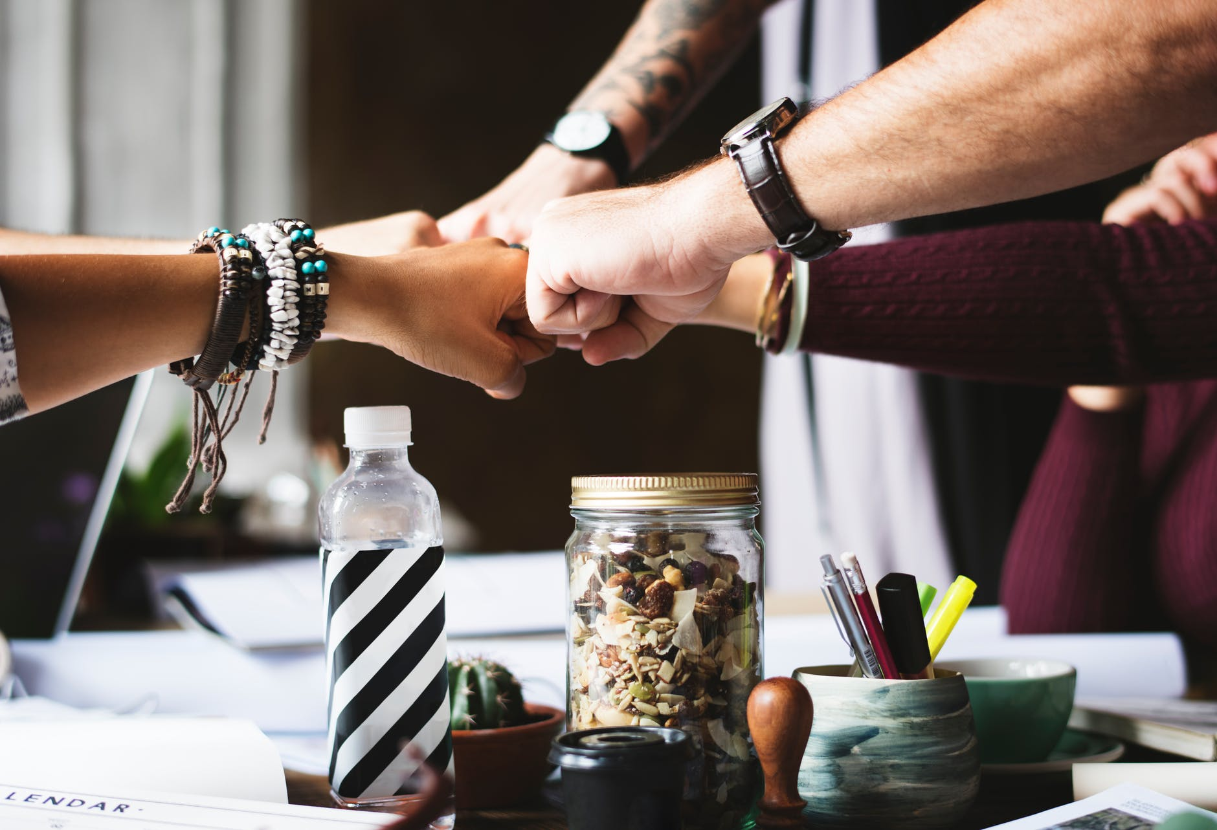
Team Urkel
Kalsang Bhutia
Robyn Craig
Kimberly Maturo-Hilt
Zac

Slide 4

Mission & Value
Mission:
Design a collaborative space that links love of the cinema and the love of munchies together for an ahhhh, ohhhhh or WOW experience.
Value:
We aim to deliver creativity and ease to our solutions as well as our love and passion for food and movies to our customer experience.

Slide 5
Project Structure
- Overall technical responsible
- Solution design advisory
- Firebase
Solution Architect
- Jquery
-Javascript
- AJAX
-API calls
Back-end Developer
- Bootstrap
- HTML
- CSS
- Visual design, imagery, graphics
Front End Developer
- Overall project management
- Jira administrator
-UX testing and issue identification
- wireframing
Project Manager
UX Tester

Slide 6
Description of Project
It’s simple, ever watch a movie?
Every think to yourself, that what the actors are eating either looks good or sounds good.
Answered YES to both the above, then CINEMUNCHIES is what you need.
We bring the munchies of the movies to you.
Search a movie
See a list of munchies
Select the desired munchie
Get the recipe
Don’t see the munchie yet, then add to our ever expanding database!
Want to know what movie to pair with a munchie, we got you covered for that too!

Slide 7
Project Selection Process
ALL IDEAS
SeeFood
Find a Dog Park
Where to Meet
TOP IDEAS
Where to meet
SeeFood
FINAL IDEA
Cinemunchies*
All team members submitted ideas
37 ideas in total
Each team member picked their Top-5
Each idea which received a rating was presented, discussed, challenged and brain-stormed the experience
Narrowed down top choices
Another team was already working on the Where to Meet
All agreed to move forward with SeeFood
New name established upon discussion and input from Jesse
Name provided by Jesse

Slide 8
Our Approach
Sprints; BrainStorming

Slide 9
Tools and Technologies
Jira
Project management
Issue logging
Visual Studio
HTML / CSS coding
Jquery/JS/AJAX coding
Multiple browser for testing
Chrome
Safari
FireFox
Multiple devices for testing responsiveness
PC
iPad
iPhone

Slide 10
Features and Functions
Features:
Mobile responsive
Images
Type ahead
Functions:
Function1
Function2
Product Demonstration:
https://zackeilholz.github.io/CineMunchies/

Slide 11
Our Challenges
Branching & Merging
work with TA
communication
A single Page format
testing, testing, testing
clearly documenting the experience
trial and error

Slide 12
Our Successes
Mobility
Functionality
Design
Team work
Positive attitudes
Willingness to listen
Adaptability
Helpfulness
Wanted a mobile solution; kept to the delivering a mobile friend solution
2 API calls
Firebase database
Clean
Crisp
Simple

Slide 13
What We Learned
Revisit ideas and solution often
Test and then test again
Communicate, there is never enough talking
Prioritize the deliverable
Notes:
Consider talking about:
Constraints vs Objectives

Slide 14

Questions & Answers

